Slide 1
CLASSIFICATION OF HEALTHY SEEDS USING DEEP LEARNING
DEPARTMENT OF COMPUTER SCIENCE
Name: AYUSH JAGGI
Roll No.: 02-MTCH-21
Under the Supervision of Prof. Vinod Sharma

Slide 2
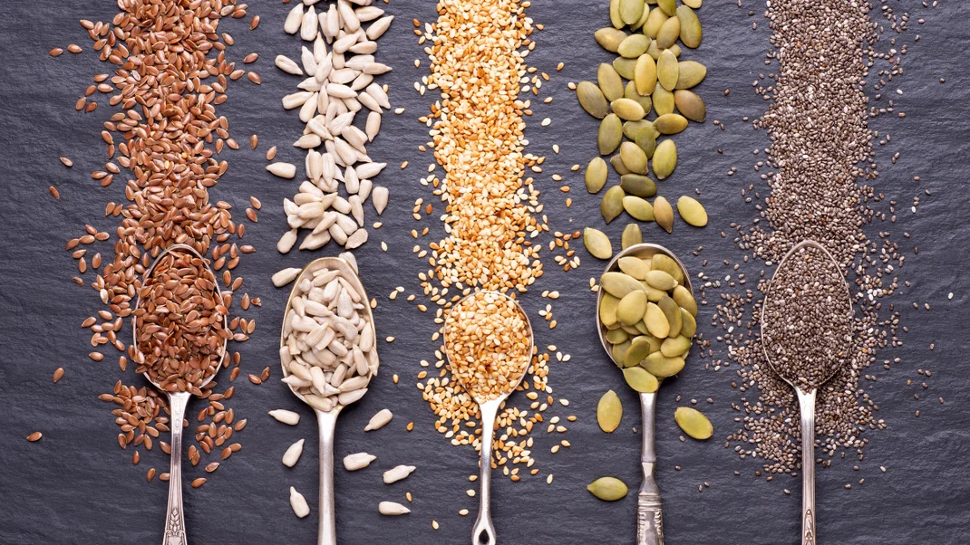
1
Introduction

Slide 3
Introduction
Agriculture is an important sector of Indian economy as it contributes about 17% to the total GDP and provides employment to over 60% of the population.
Seeds accounts for 20 – 25% of agricultural productivity in India. Seeds help in meeting country’s food and nutritional security need.
The motivation for this project is to build an automatic system for detection and recognizing Healthy Seeds for food image researchers and dietician to make proper analysis of nutrition.

Slide 4
What are Healthy Seeds?
An edible seed is a seed that is suitable for human or animal consumption. Seeds are the dominant source of human calories and protein. A wide variety of plant species provide edible seeds. Healthy seeds are seeds that can be eaten as a food and are nutritionally beneficial.

Slide 5
Benefits
Some of the potential benefits of consuming Healthy Seeds includes:
Supports Weight Loss
Boost Digestive Health
Regulate Blood Sugar
Good Source of Plant-Based Protein
Incredibly Nutrient-Dense

Slide 6
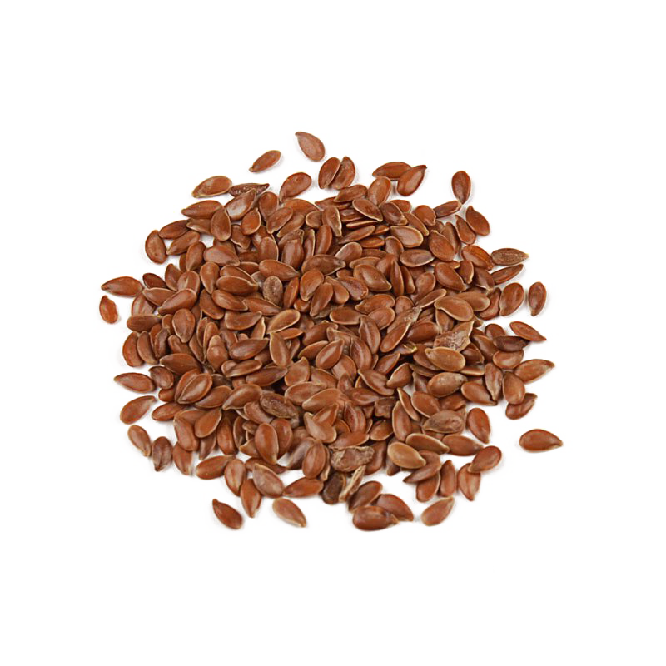
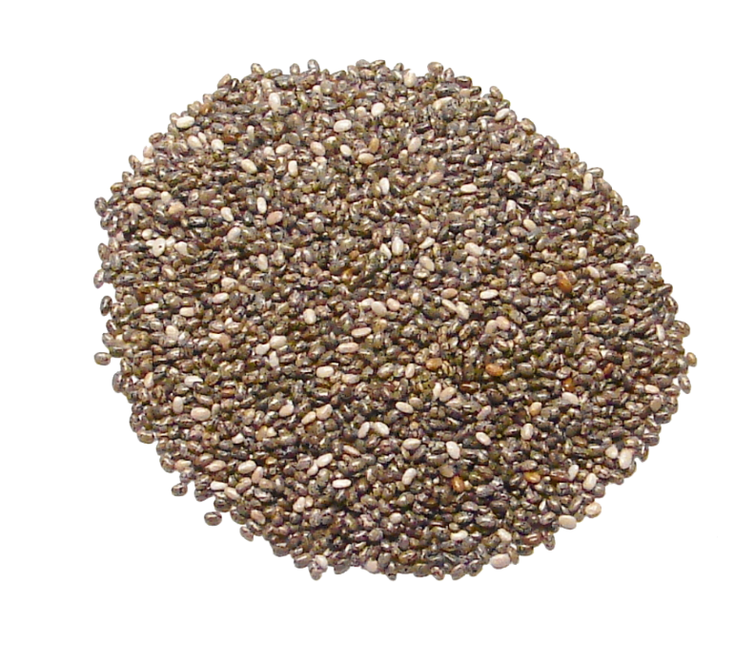
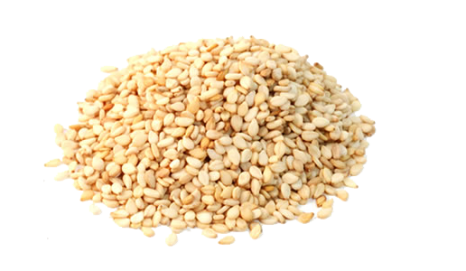

Types of Healthy Seeds
Seeds are a versatile ingredient that can be used to add a quick pop of texture and nutrition to nearly any meal.
The following are the different types of healthy seeds:
FLAX SEEDS
CHIA SEEDS
SESAME SEEDS
These fiber-packed seeds are rich in healthy omega-3 fats and provide a substantial amount of protein. Adding Flax seeds to your diet can also reduce your blood sugar, as well as your risk of cancer and heart disease.
Just two tablespoons of these seeds provide a whopping 10 grams of dietary fiber. These are loaded with healthy Omega-3 fats and can increase ALA in the blood. These can also absorb up to ten times the amount of water that they’re put in.
Sesame seeds are one of the best dietary sources of lignans—molecules that have antioxidant and anti-inflammatory effects—and may reduce inflammation and oxidative stress

Slide 7
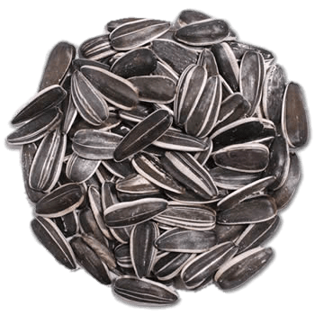
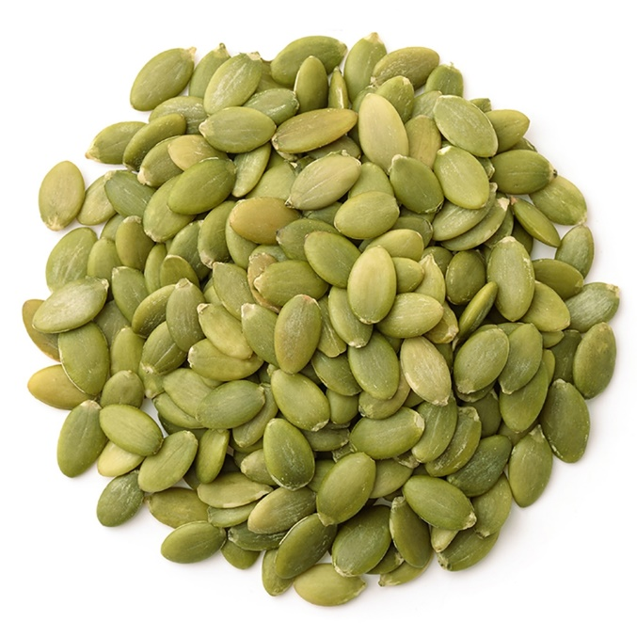
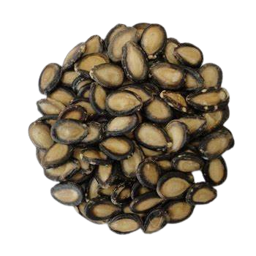
Types of Healthy Seeds
Seeds are a versatile ingredient that can be used to add a quick pop of texture and nutrition to nearly any meal.
The following are the different types of healthy seeds:
SUNFLOWER SEEDS
PUMPKIN SEEDS
WATERMELON SEEDS
Sunflower seeds are “abundant in monounsaturated fats, Vitamin E, and protein…and eating [them] a few times a week has been shown to reduce inflammation.
Pumpkin seeds, also known as pepitas, are a popular seed with an obvious origin. They’re also loaded with monounsaturated and omega-6 fats and boast serious health benefits for the bladder and urinary tract.
Its seeds are super-rich in various nutrients. These seeds have a low-calorie count and are rich in micronutrients like zinc, magnesium, potassium, etc. These boost immunity and heart health and help to control blood sugar levels.

Slide 8

2
Literature Review

Slide 9
LITERATURE REVIEW
Year | Author | Title | Summary
2018 | F. Femling, A. Olsson, F. A. Fernandez | Fruit and Vegetable Identification Using Machine Learning for Retail Applications | Described an approach of creating a system identifying fruit and vegetables in the retail market using images captured with a video camera attached to the system.
2018 | D. Agrawal, P. Dahiya | Comparisons of classification algorithms on seeds dataset using machine learning algorithm | Conducted a comparative study on ML algorithms aimed to classify various grain seeds by using logistic regression (LR), Linear Discriminant Analysis, k-Nearest Neighbours classifier, Gaussian Naïve Bayes and support vector machine.

Slide 10
LITERATURE REVIEW
Year | Author | Title | Summary
2020 | J. L. R. Aranda, J. I. N. Varela, J. C. C.Tello, G. R. Ramirez | Fruit Classification for Retail Stores Using Deep Learning | Presented an image classification method, based on lightweight Convolutional Neural Networks (CNN), with the goal of speeding up the checkout process in stores. The results show an overall 95% classification accuracy for fruits with no plastic bag, and 93% for fruits in a plastic bag.
2020 | F. Kurtulmuş | Identification of sunflower seeds with deep convolutional neural networks | Used DL models for the identification of sunflower seeds. They overcome the problem of overfitting by using optimization algorithms. The authors claimed that the optimized Google Net model achieved an accuracy of 95%.

Slide 11
LITERATURE REVIEW
Year | Author | Title | Summary
2020 | S. Bhattacharya, J. Mukherjee | Recognition of Indian Spices based on the Combination of Features and Comparison using Neural Network | Proposed spices image identification system for Indian food images. Considered a nearly 80 single Indian spices images of 4 classes. They achieved 96.7% accuracy.
2021 | G. Zhao, L. Quan, H. Li, S. Li, S. Zhang | Real-time recognition system of soybean seed full-surface defects based on deep learning | considered the full surface of soybean seed. They followed circumrotating mechanism for full surface detection and reported an accuracy of 98.87%.

Slide 12

PROBLEM STATEMENT
By reviewing the relevant works of literature and the problems related to the previous research papers, it is noticed that there is a requirement of applying a suitable Deep learning algorithm for classification of Healthy Seeds. This study can help to build a better classifying model of Healthy seed types using a suitable Deep learning algorithm.

Slide 13

3
EXPECTED CONTRIBUTION
OF THE STUDY

Slide 14
Expected Contribution
Area of Study
The proposed study will be done on a real dataset as the domain of work is new and no dataset is available on internet and will be carried out on Python platform by the implementation of Deep learning technique.

Slide 15
Expected Contribution
Objectives
To carry out thorough study on Healthy seeds and its benefits.
To analyze deep learning techniques in the classification of seeds and evaluate the performance of implemented undertaken deep learning techniques based on parameters such as accuracy, recall, precision, f-score.
To develop a Healthy seeds Recognition framework based on Deep learning to recognize different seeds.

Slide 16

4
Research
Methodology

Slide 17
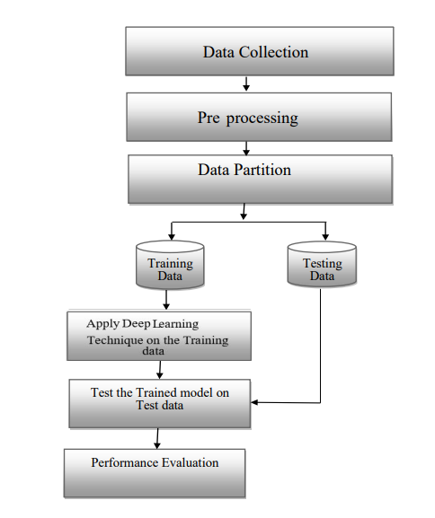
Research Methodology

Slide 18
REFERENCES
Femling, F., Olsson, A. and Alonso-Fernandez, F. (2018) “Fruit and vegetable identification using machine learning for retail applications,” 2018 14th International Conference on Signal-Image Technology & Internet-Based Systems (SITIS) [Preprint]. Available at: https://doi.org/10.1109/sitis.2018.00013
Agrawal, D. and Dahiya, P. (2018) “Comparisons of classification algorithms on seeds dataset using machine learning algorithm,” Compusoft [Preprint].
Rojas-Aranda, J.L. et al. (2020) “Fruit classification for retail stores using Deep Learning,” Lecture Notes in Computer Science, pp. 3–13. Available at: https://doi.org/10.1007/978-3-030-49076-8_1
Kurtulmuş, F. (2020) “Identification of sunflower seeds with deep convolutional neural networks,” Journal of Food Measurement and Characterization, 15(2), pp. 1024–1033. Available at: https://doi.org/10.1007/s11694-020-00707-7
S. Bhattacharya and J. Mukherjee, “Recognition of Indian Spices based on the Combination of Features and Comparison using Neural Network”, International Research Journal of Engineering and Technology (IRJET), Vol. 7, 2020
Zhao, G. et al. (2021) “Real-time recognition system of soybean seed full-surface defects based on deep learning,” Computers and Electronics in Agriculture, 187, p. 106230. Available at: https://doi.org/10.1016/j.compag.2021.106230.

Slide 19
Thank you!
Any questions?
Dissertation Phase 1 | University of Jammu

